Slide 1

Analysis of crime in NYC with Time Series Model and RNN Approaches
Applied Data Science
Fall 2023
Final Presentations - April 28th, 2023

Slide 2
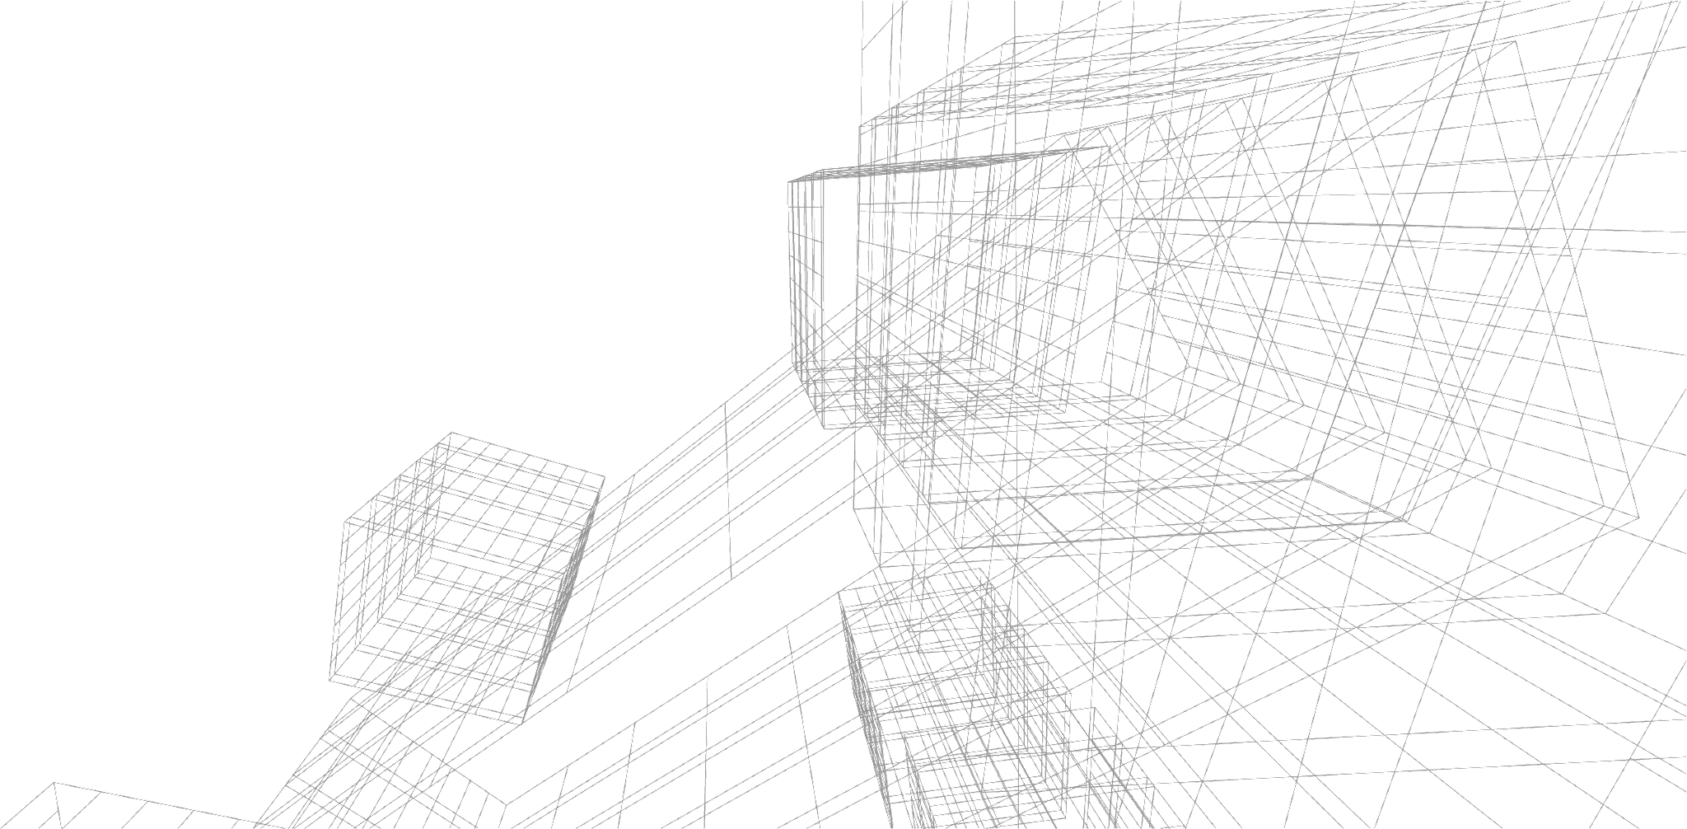
Table of Contents
Background and Goal Research
Literature Review
Time Series Data Analysis
SARIMA Model Training
A Fine-grained Attempt: Cluster Analysis + SARIMA
Neural Network Prediction: NN & RNN
Limitations

Slide 3
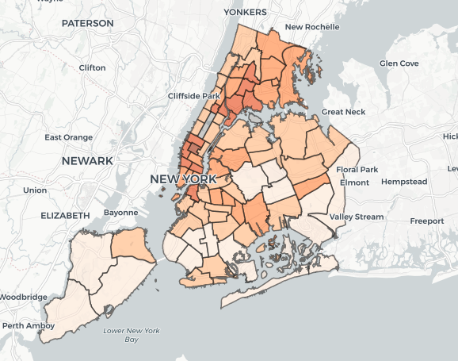
Background and Goal of Research
Crime has always been a research hotspot. However, due to the deficiency of spatiotemporal crime data, limited efforts have been made to a fine-grained level.
We hope to take NYC as an example, take advantage of the rich crime data on NYC Open Data, conduct research on the spatial and temporal distribution of crime in the city, find a suitable research method (model), and provide reference for countermeasures against crime.

Slide 4
Literature Review
Alkaff, M., Mustamin, N. F., & Firdaus, G. A. A. (2023, March 6). Prediction of crime rate in Banjarmasin city using RNN-GRU model. International Journal of Intelligent Systems and Applications in Engineering. Retrieved April 28, 2023
Crime hot spot forecasting: A recurrent model with ... - IEEE xplore. (n.d.). Retrieved April 29, 2023
Noor, T. H., Almars, A. M., Alwateer, M., Almaliki, M., Gad, I., & Atlam, E.-S. (2022, December 1). Sarima: A seasonal autoregressive integrated moving average model for crime analysis in Saudi Arabia. MDPI. Retrieved April 28, 2023
Stec, A., & Klabjan, D. (2018, June 5). Forecasting crime with Deep Learning. arXiv.org. Retrieved April 28, 2023

Slide 5
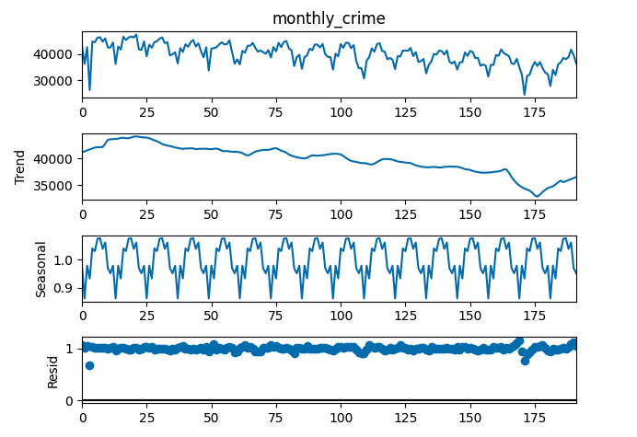
Seasonal Decomposition
Once we set the period as 12, there will be a strong Seasonal pattern from row 3
This leads us to us the SARIMA model.

Slide 6
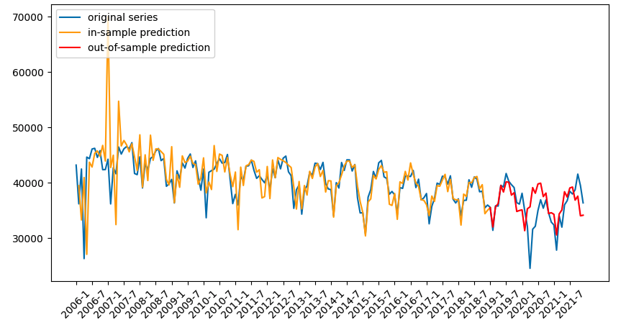
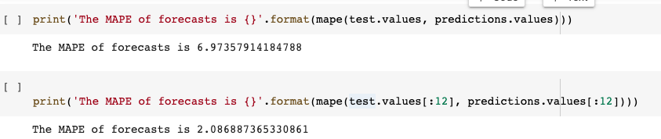
The result of using SARIMA model
Training data set:
2006 - 2018(156 months)
Testing data set:
2019-2021(36 months)
As we can see, except in 2020 (Impacted by Covid-19), the model predicts pretty accurately.
This proves that crime numbers are predictable.

Slide 7
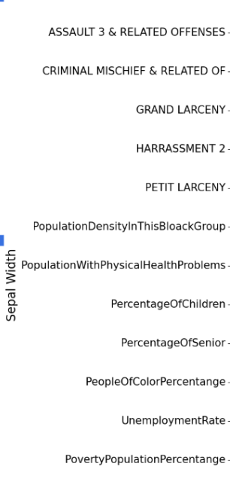
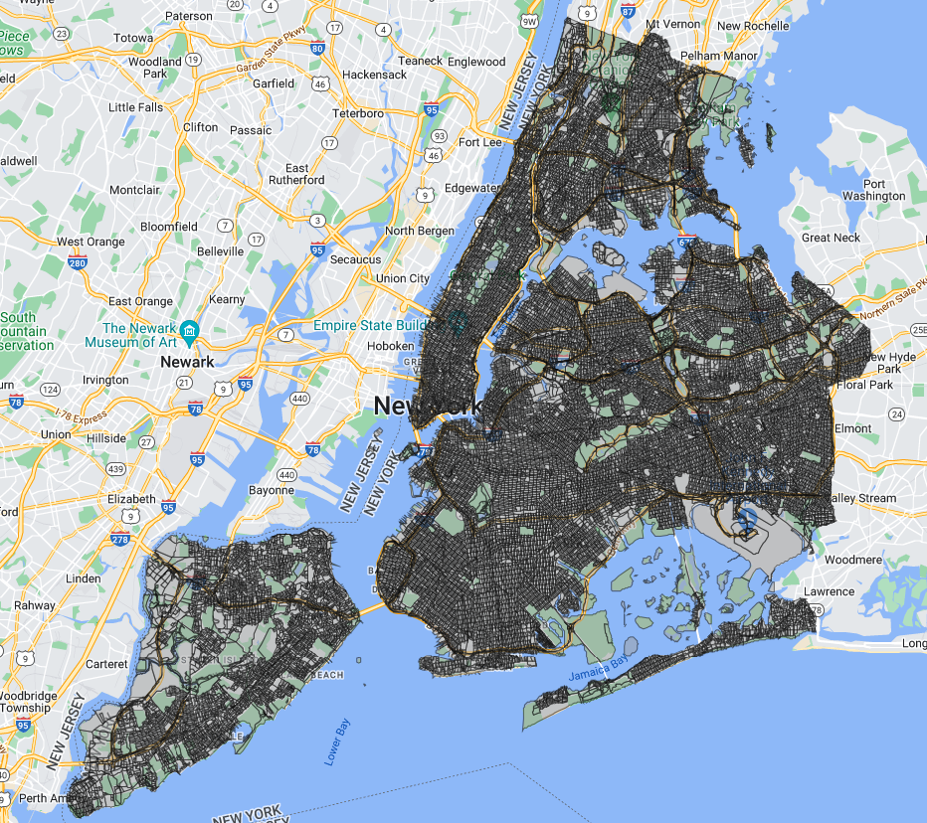
How can we do a more fine-grained analysis?
Based on the features those are related to crime, we clustered the 6211 census block of NYC into 3 groups.

Slide 8
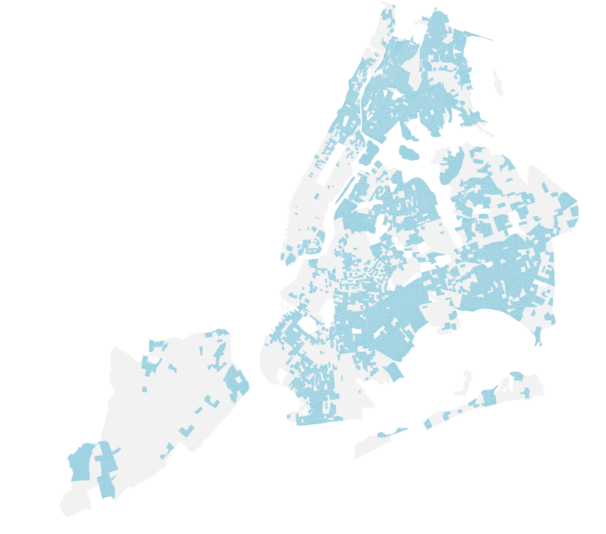
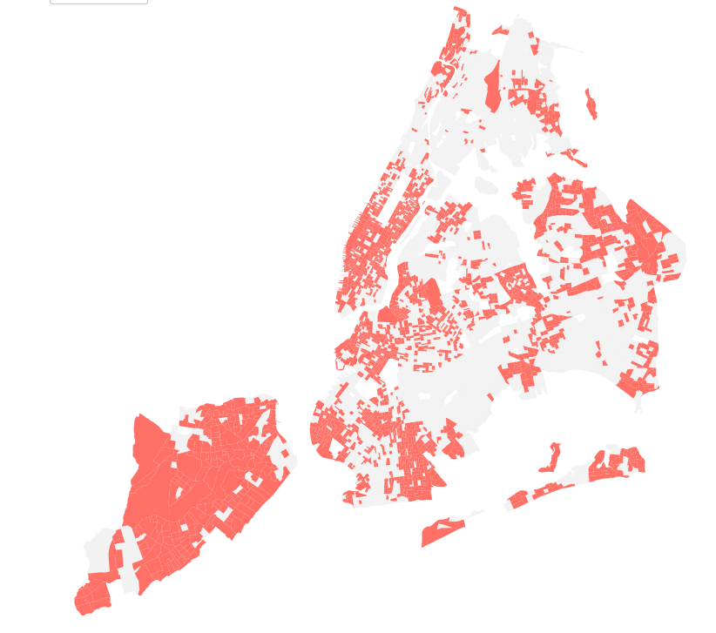
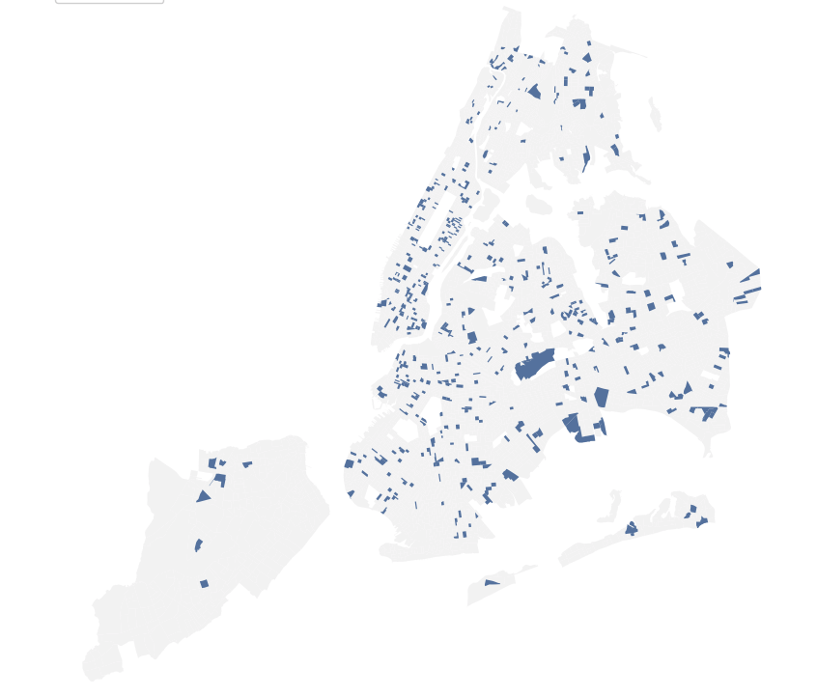
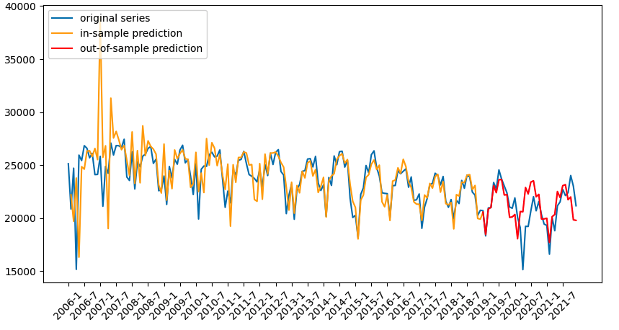
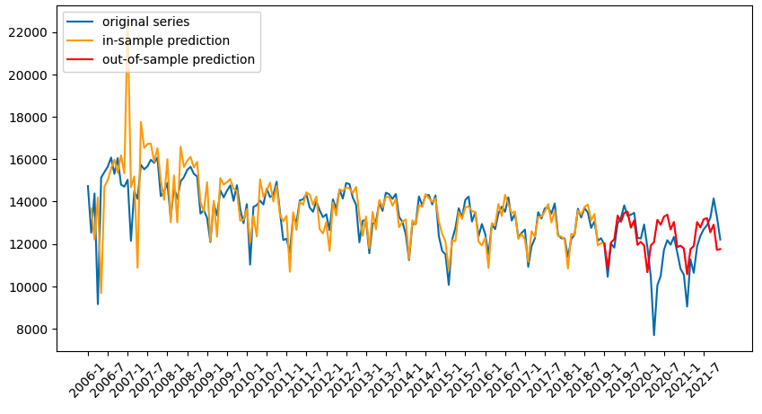
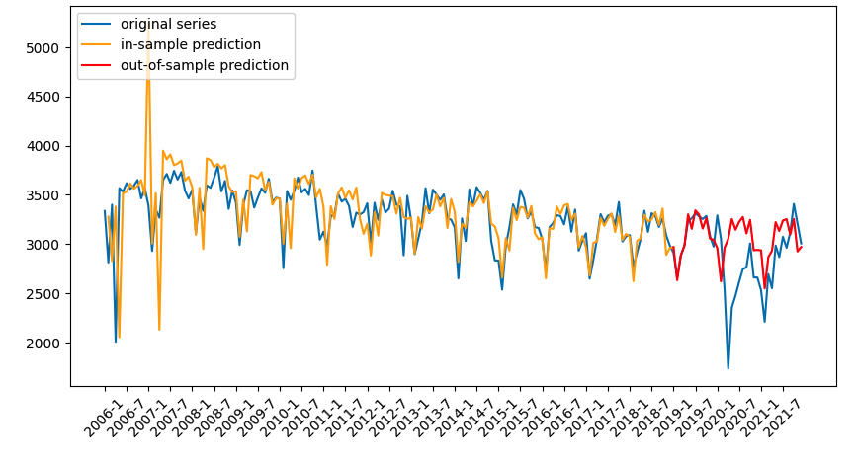
How can we do better?

Slide 9
For more accurate result , we have to use Neural Network Prediction

Slide 10
Comparison between Models
 | Focus | Pros | Cons
Linear Regression | Linear relationship between features and target variables | High interpretability; Features considered | Excluding the effect of past values
Time series | Relationship between the current target variables and their past values | High interpretability; Past values considered | Excluding the effect of demographic and spatial features
Neural Network | Non-linear regression by inputs | High accuracy | Low interpretability; Excluding the effect of past values
Recurrent Neural Network | Recalls the past and motivated with the aid of what it has learned from the past | Considering both features and the past values; High accuracy | Low interpretability

Slide 11
Data Preparation
Spatial Feature: Latitude and longitude and its projection to census block.
Temporal Feature: Counts of crime in different months.
Demographic Feature: Index from American Community Survey.
Map Data
Spatial Feature
Training Data
Training Data
Proposed Model
Crime Data
Temporal Feature
Validation Data
Testing Data
Trained Model
Census Data
Demographic Feature
Trained Model

Slide 12
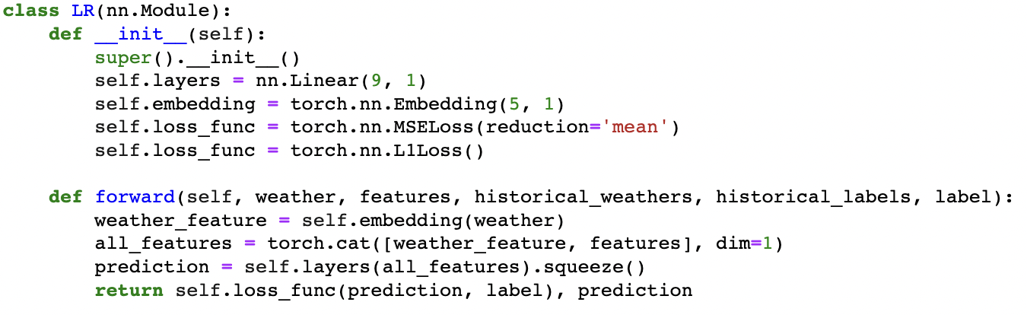
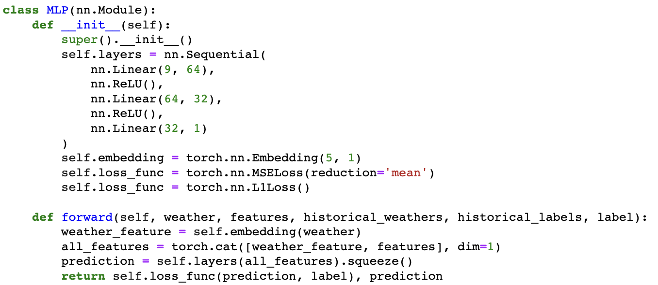
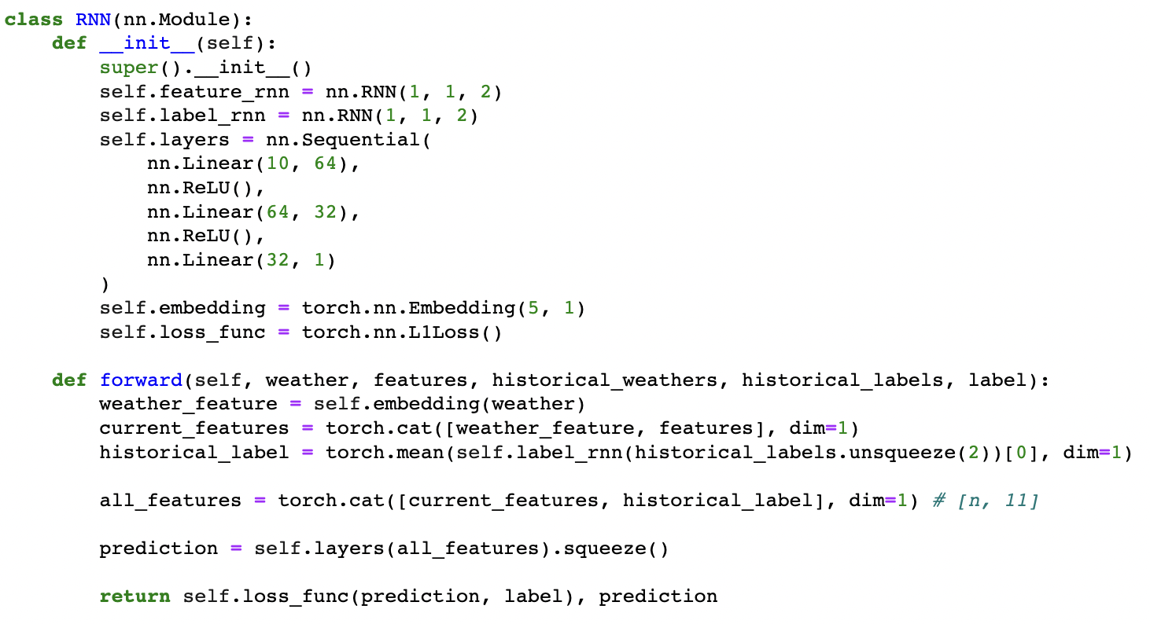
Methodology
Linear Regression: serving as a good baseline
Neural Network: using two fully-connected layers with ReLu as the activation function
Recurrent Neural Network: using temporal data, giving the best performance
LR
NN
RNN
Model | Test loss
Linear Regression | 12.32
Neural Network | 4.14
RNN | 2.83

Slide 13
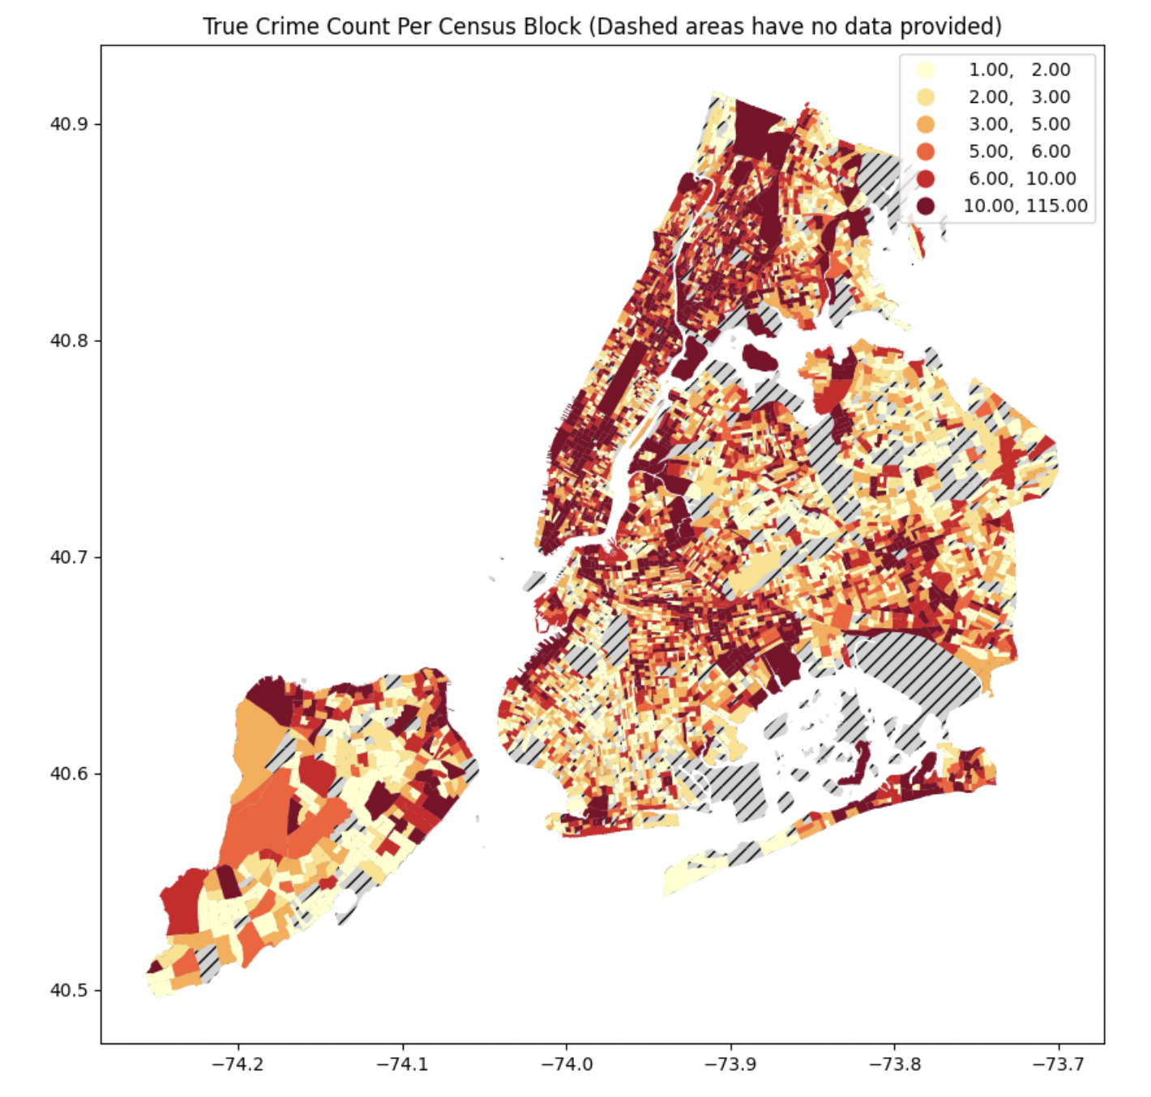
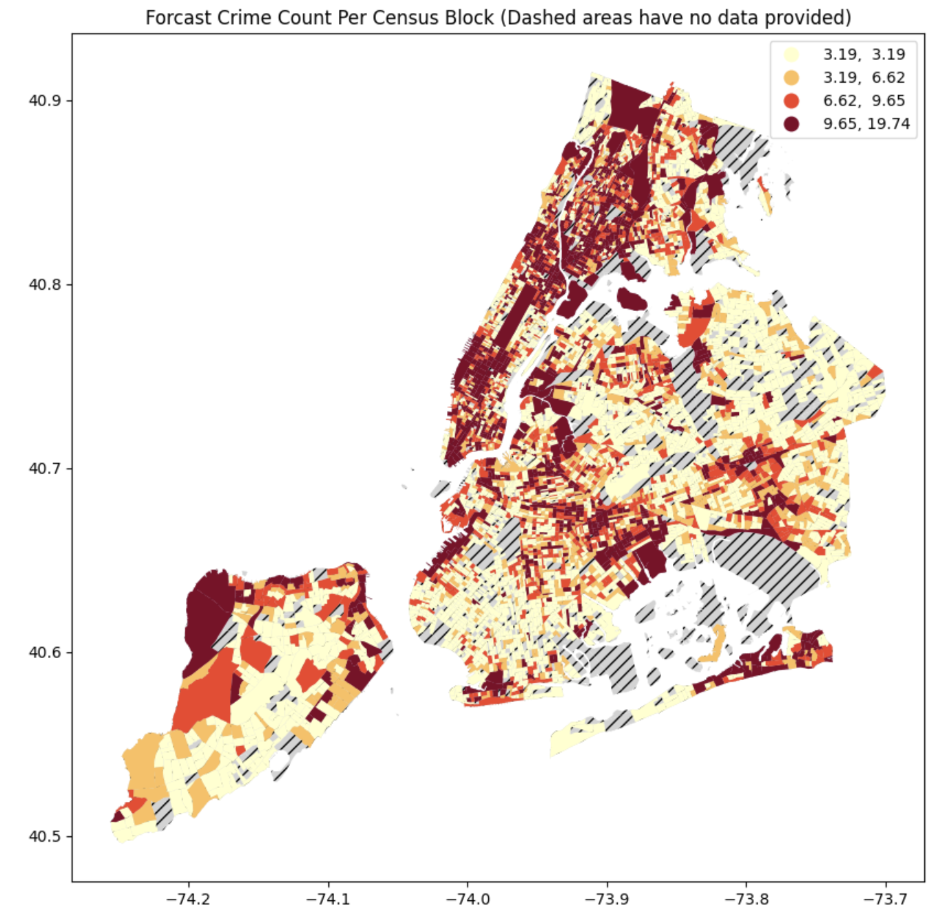
Result - Summer
The prediction is relatively similar to the actual crime.
For Queens, Brooklyn, and Staten Island, there is a little overprediction.
Figure: The ground truth and prediction of 2020-08

Slide 14
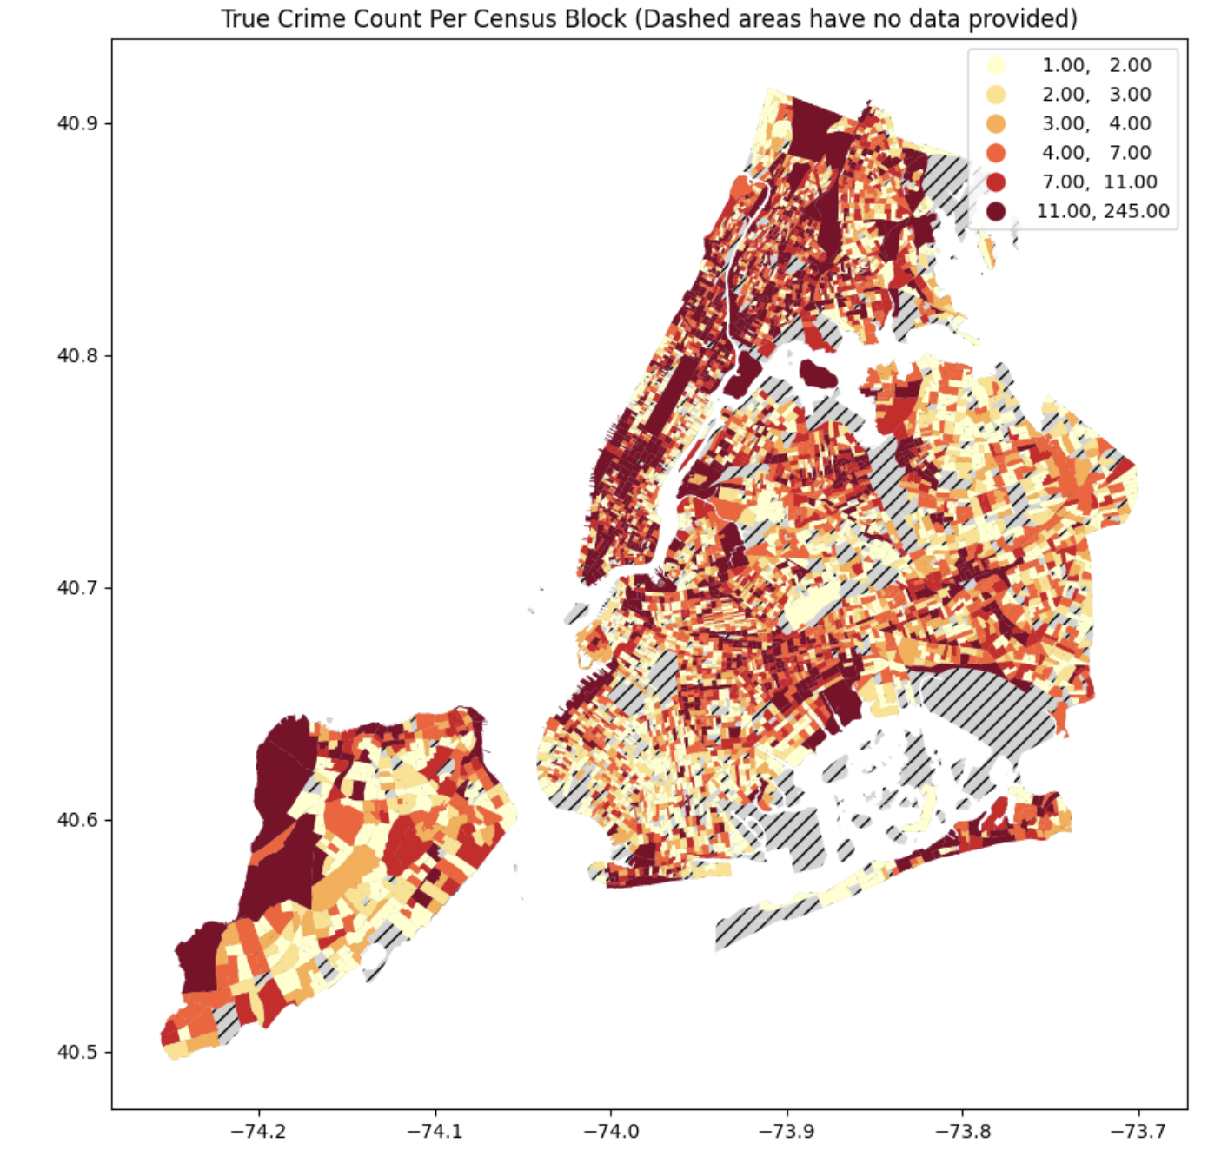
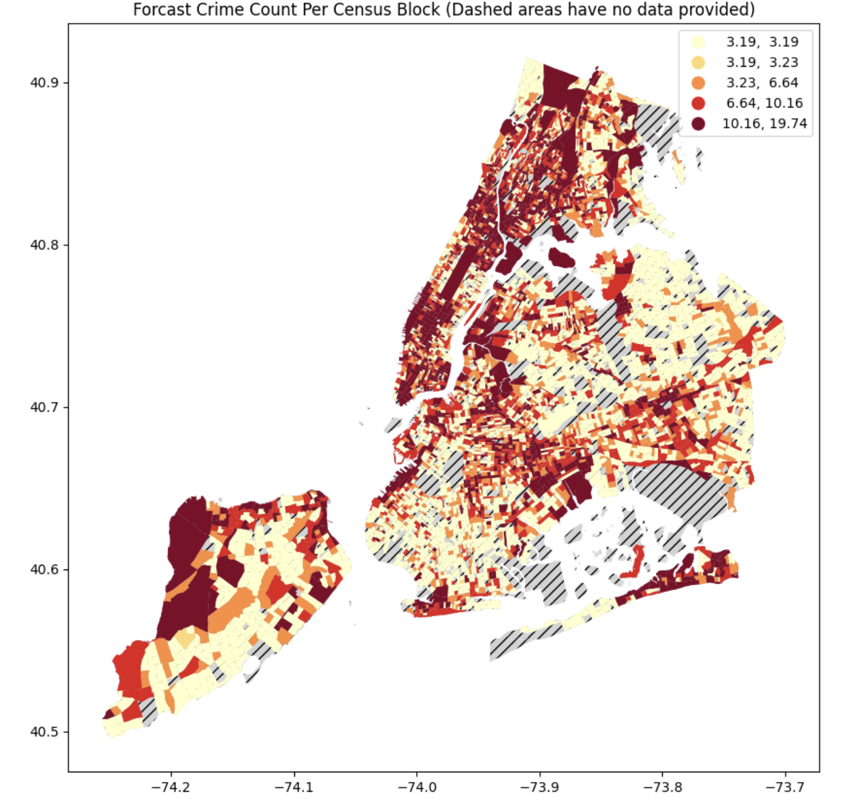
Result - Winter
Similarly, there prediction for Manhattan and Bronx is more accurate than other boroughs.
However, it seems the crime for Queens, Brooklyn, and Staten Island is underpredicting.
Figure: The ground truth and prediction of 2021-11

Slide 15
Limitations
Because the computer efficiency is not enough, the study currently uses the monthly crime data aggregated instead of daily, which may contain some bias. In further study, using daily data might be a better option.
The study only included a few features regarding to population, housing and weather. There are still a lot of possible features which need to be explored in the future.
The loss of current model RNN is 2.83, which still has room for improvement. More complicated models might be tried in later study.

Slide 16
THANKS
Team Members:
Dapeng Lin(dl4906), Qinchan Li(ql840), Shanshan Xie(sx2230), Junru Song(js12921), Yifan Zhang(yz8983), Yuanbo Zhang(yz9471)
(Sorted by Last name)

